Slide 1
Brainstorming for a Climate State (mostly temperature) Dashboard
Baylor Fox-Kemper, Richard Betts, Samantha Burgess, Ed Hawkins, Zeke Hausfather, John Kennedy, Colin Morice, John Nicklas, Anna Pirani, Robert Rohde
First, let’s see what C3S has on their dashboard!

Slide 2

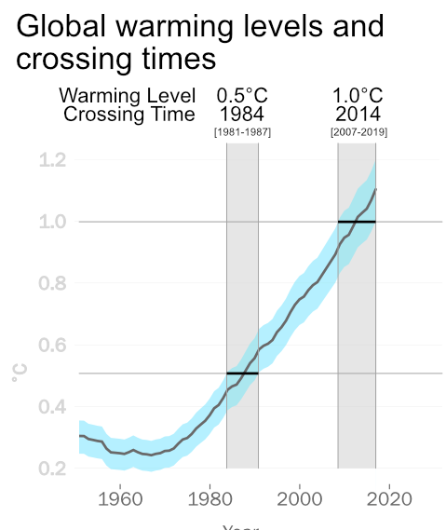
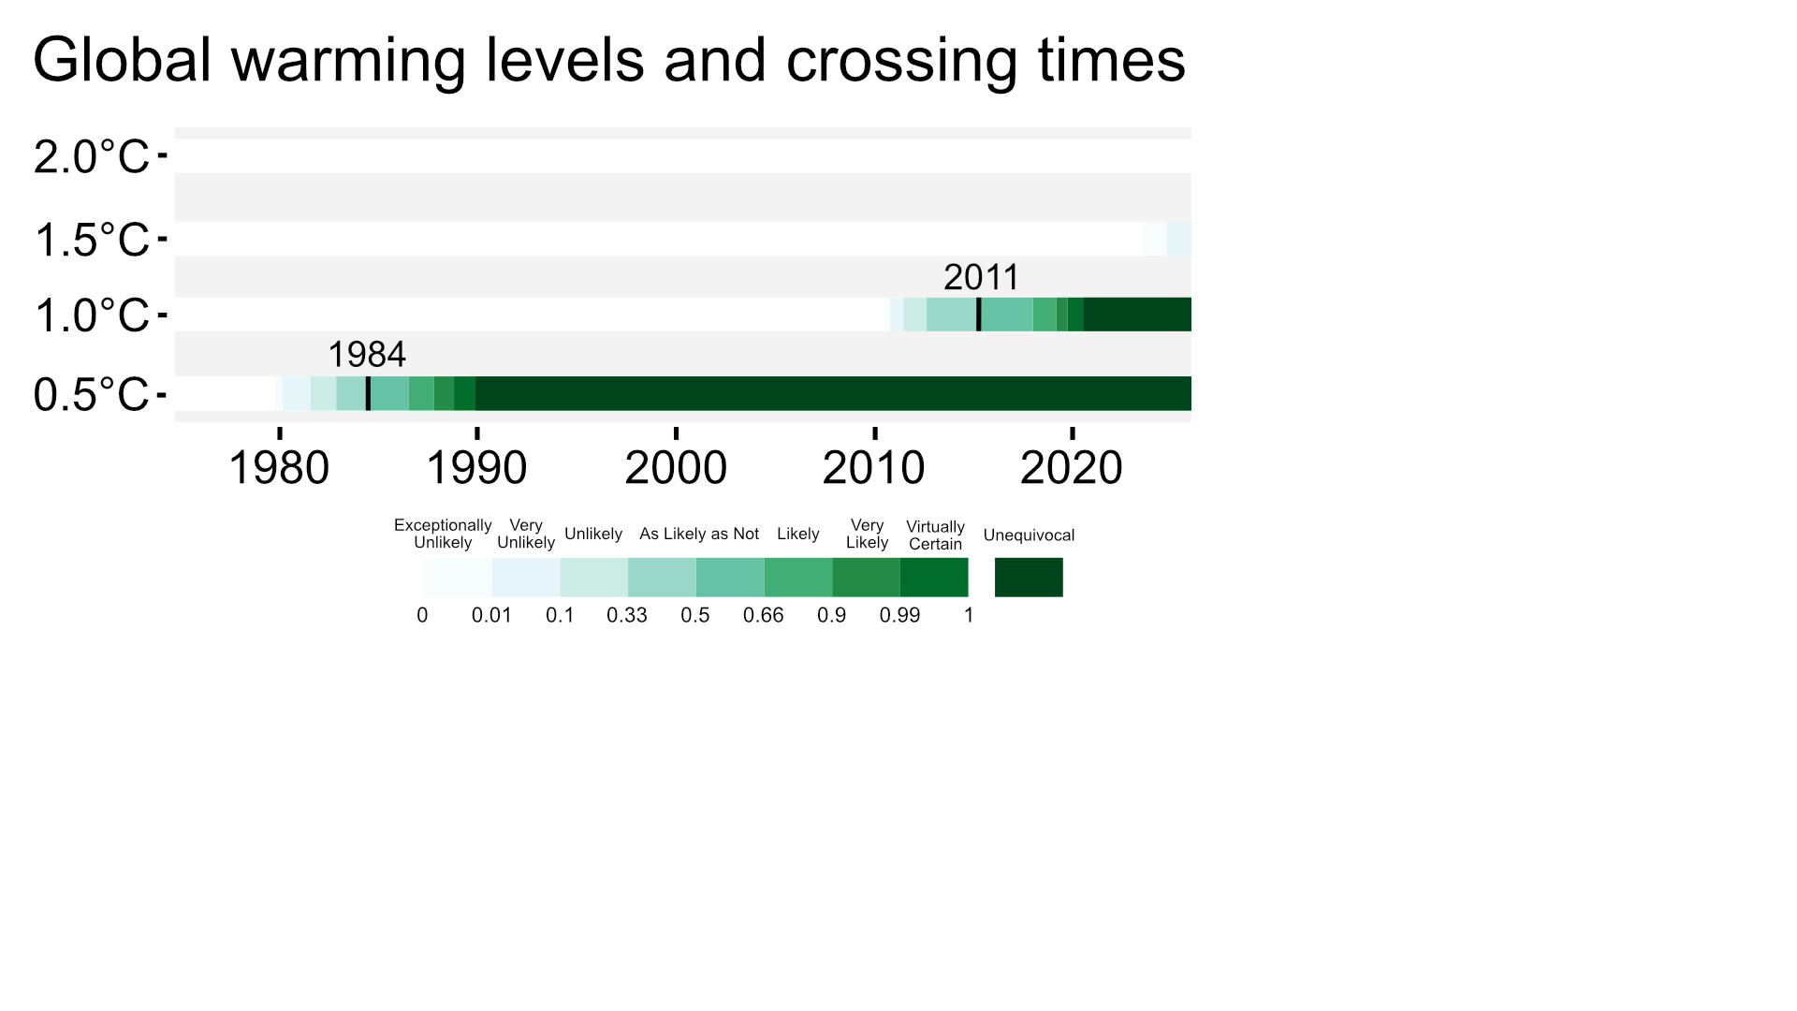
Realized Climate System Warming
Lines of evidence
Current (2024) global warming level:
1.3 °C [1.2 - 1.4, 95% uncertainty range]
Current (2024) global warming rate:
0.2983 ± 0.0640 °C/decade
It is exceptionally unlikely that global warming has exceeded 1.5°C
1984
2010
0.2090 ± 0.0292
°C/decade
0.1516 ± 0.0246
°C/decade
2010
1984
Download data - Explore lines of evidence

Slide 3
Attributed Climate System Warming
Lines of evidence
Current (2024) attributed global warming level:
1.3 °C [1.2 - 1.4, 95% uncertainty range]
Current (2024) attributed global warming rate:
?? °C/decade [?? - ??, 95% uncertainty range]
It is exceptionally unlikely that global warming has exceeded 1.5°C
??
°C/decade
??
°C/decade
Download data - Explore lines of evidence

Slide 4
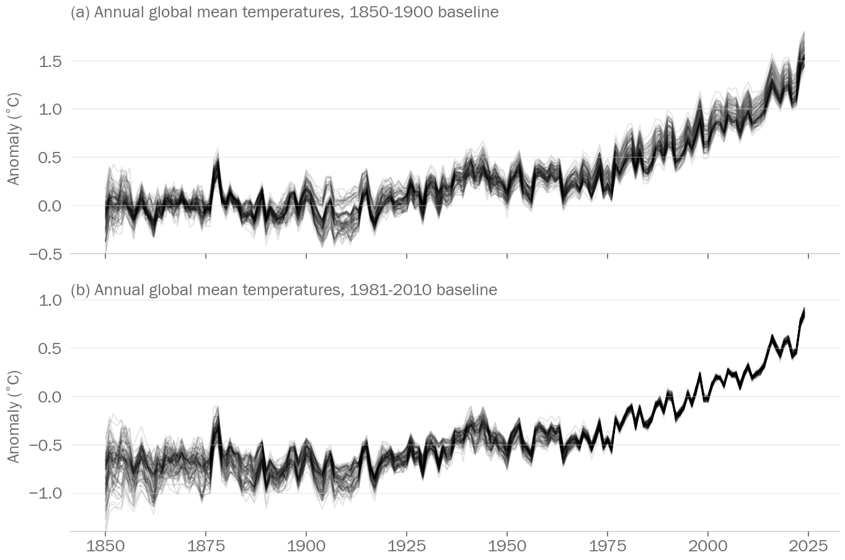
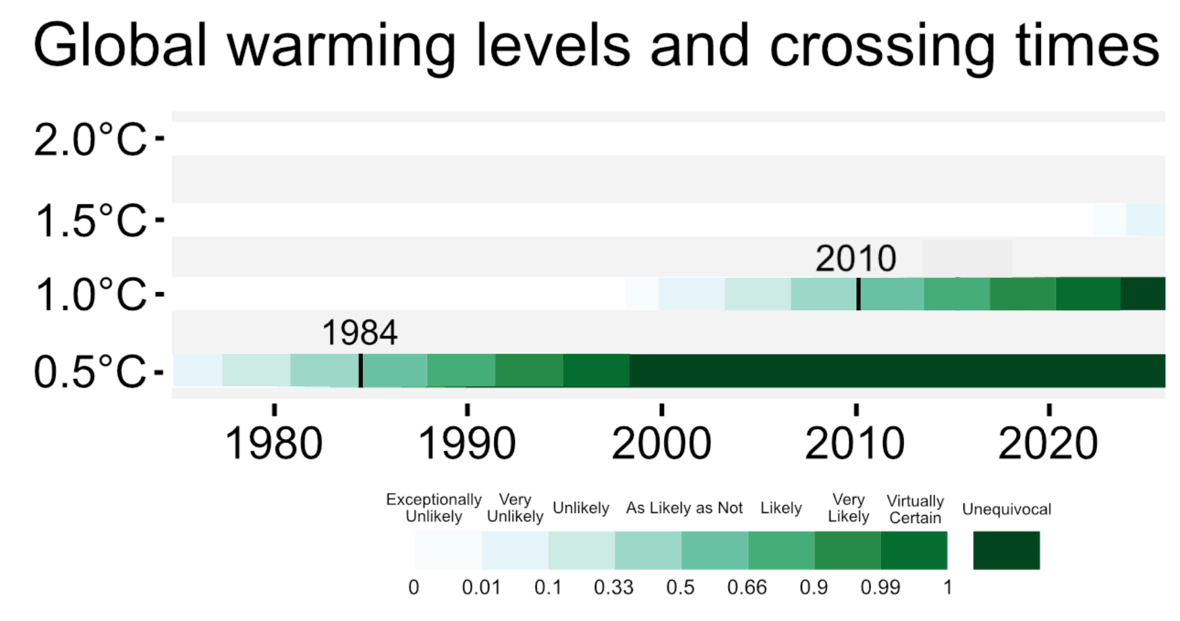
Realized Climate System Warming
PIVW Combination
Based on the pointwise inverse-variance weighting (PIVW) combination:
Current (2024) realized global warming level from PIVW:
1.40 [1.234 - 1.578]°C, 95% uncertainty range
Current (2024) realized global warming rate from PIVW:
0.32 [0.295 - 0.347]°C/decade, 95% uncertainty range
It is very unlikely that global warming has exceeded 1.5°C
1984 2010
[1974-1994] [2002-2018]
1.5
1.0
0.5
0.0
-0.5
0.167±0.039
°C/decade
0.236±0.057
°C/decade
Download data - Explore lines of evidence
Key References: Cochran, 1954, Lee et al., 2016

Slide 5


Slide 6
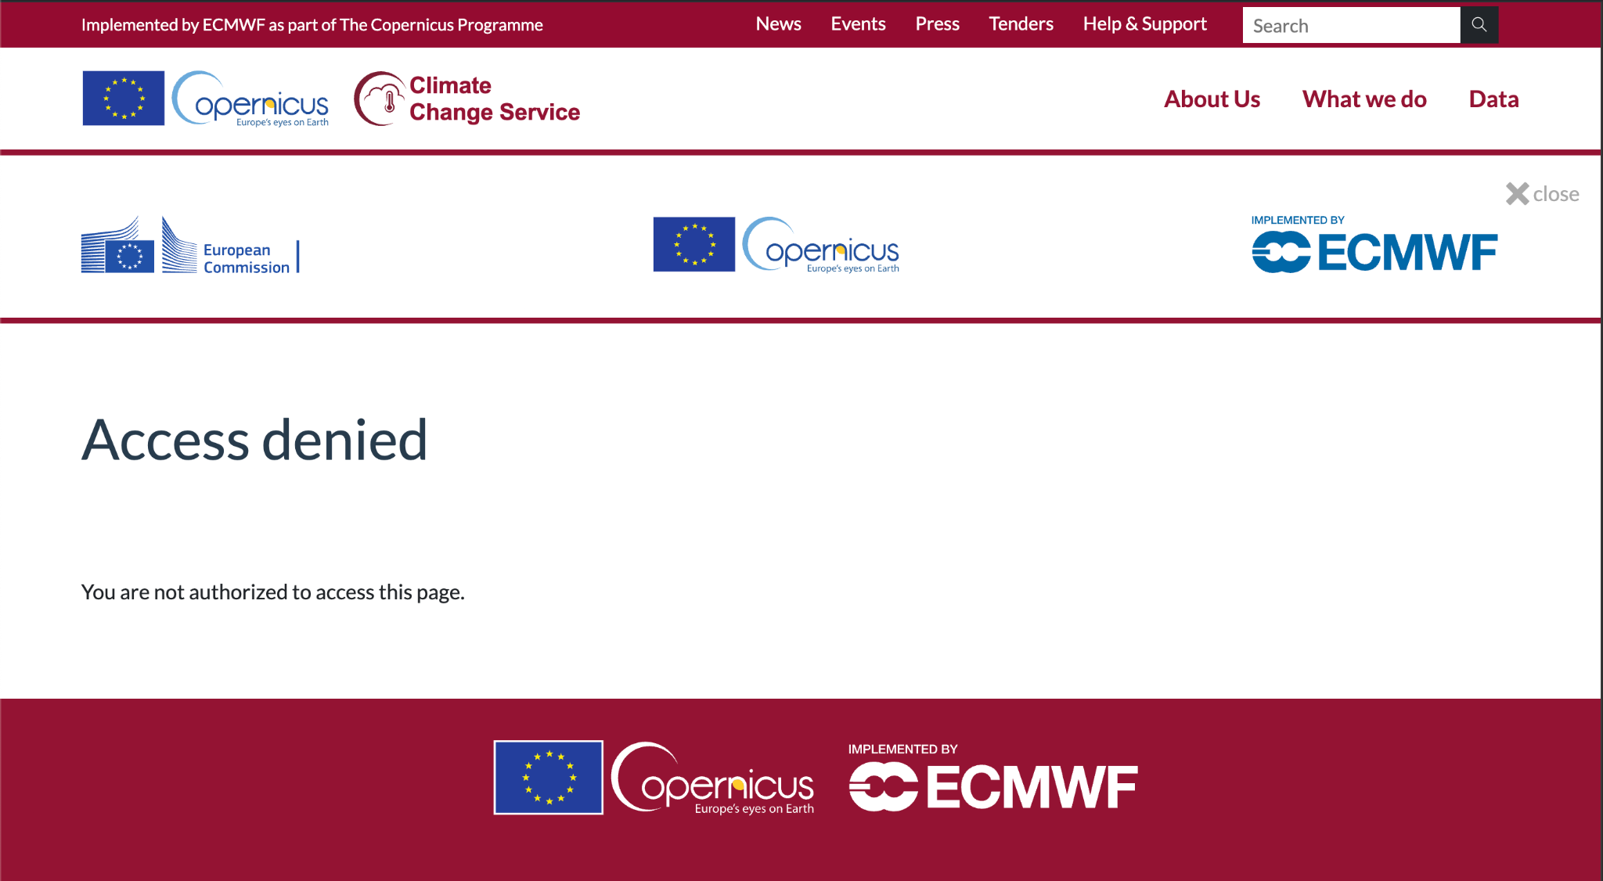

Slide 7
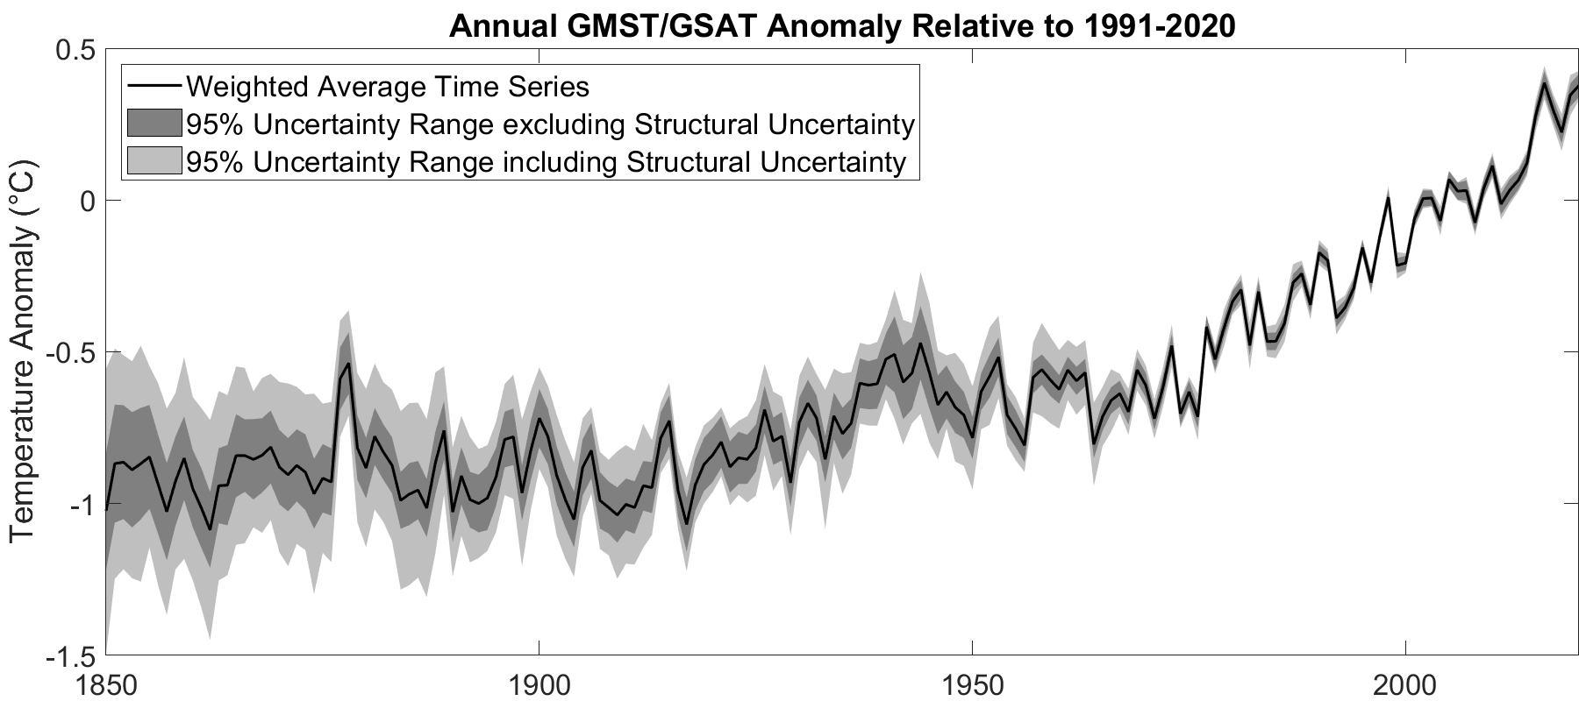
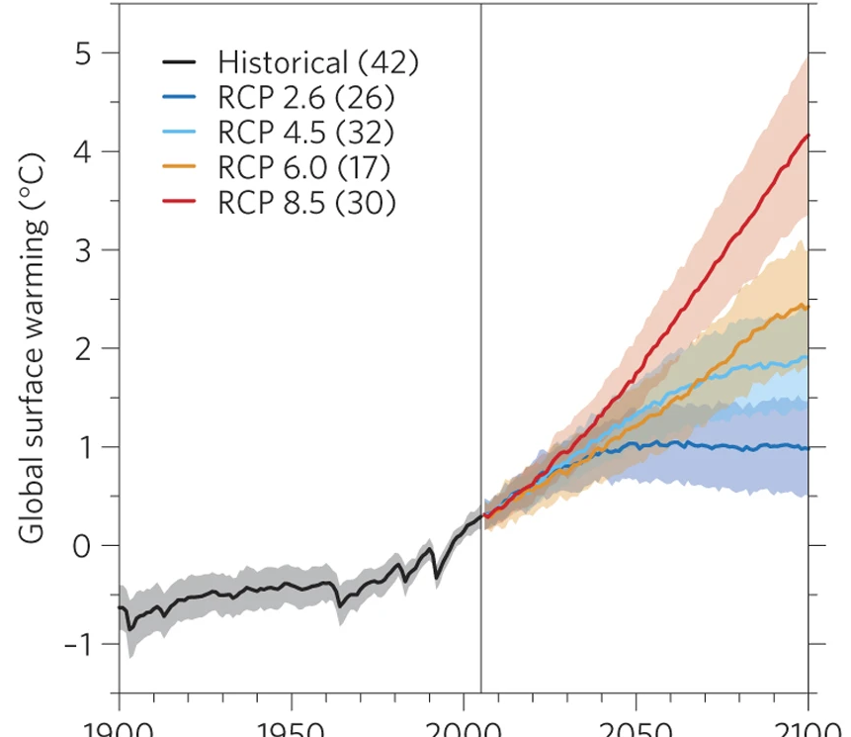
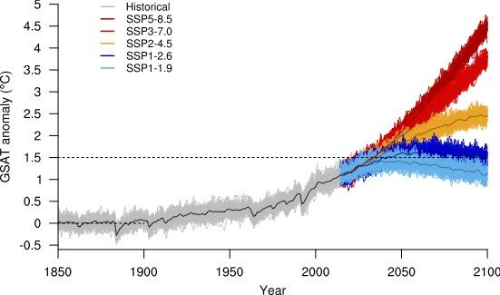
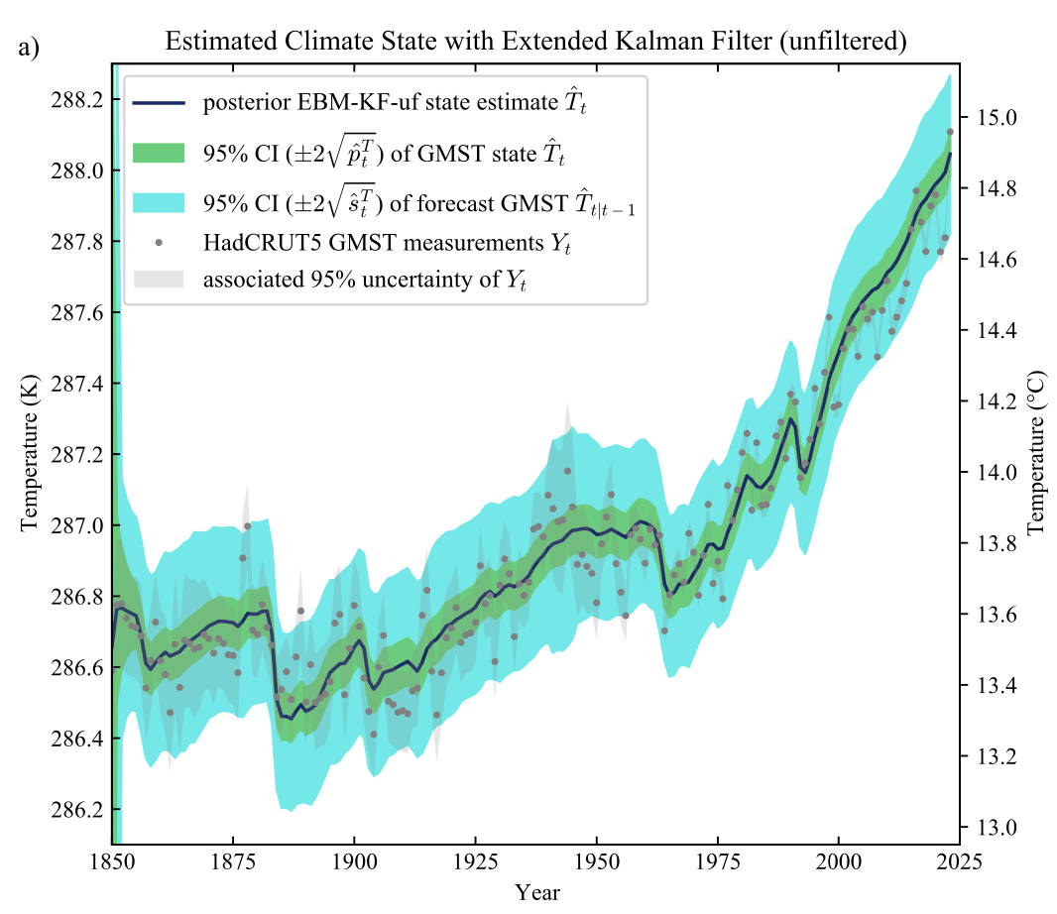
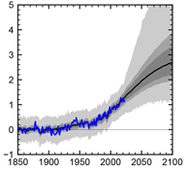
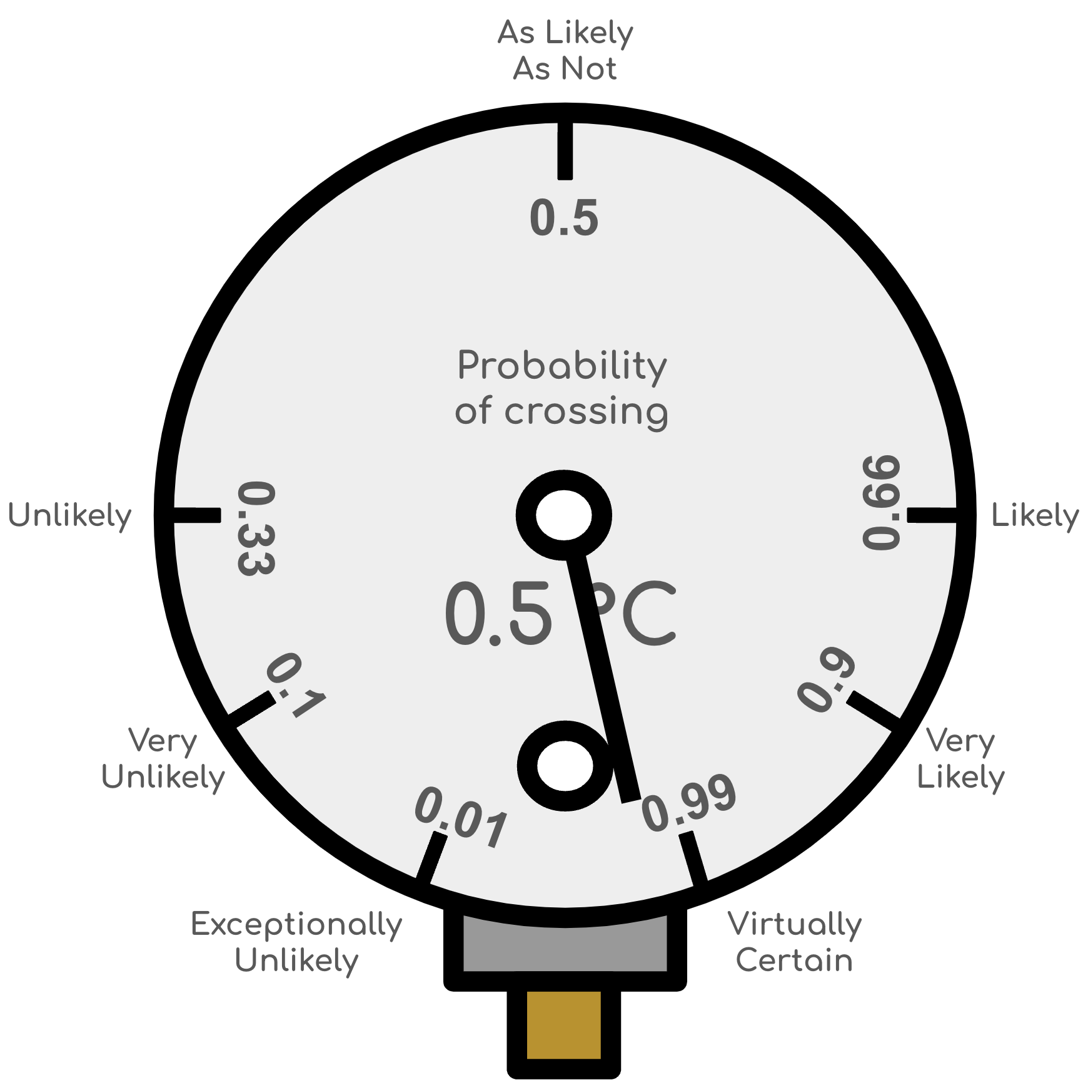

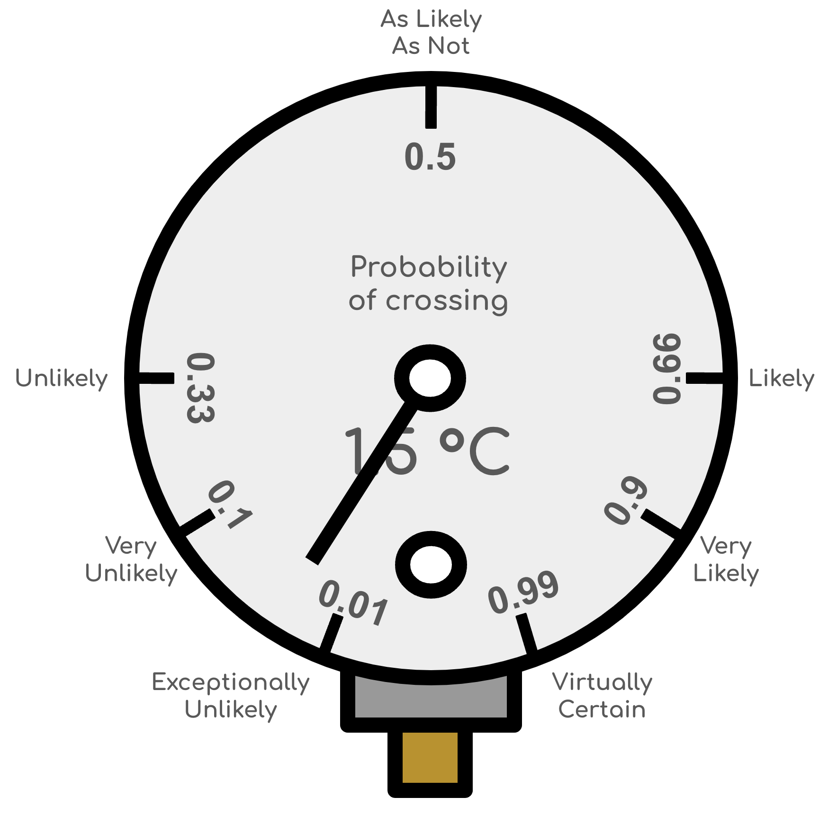
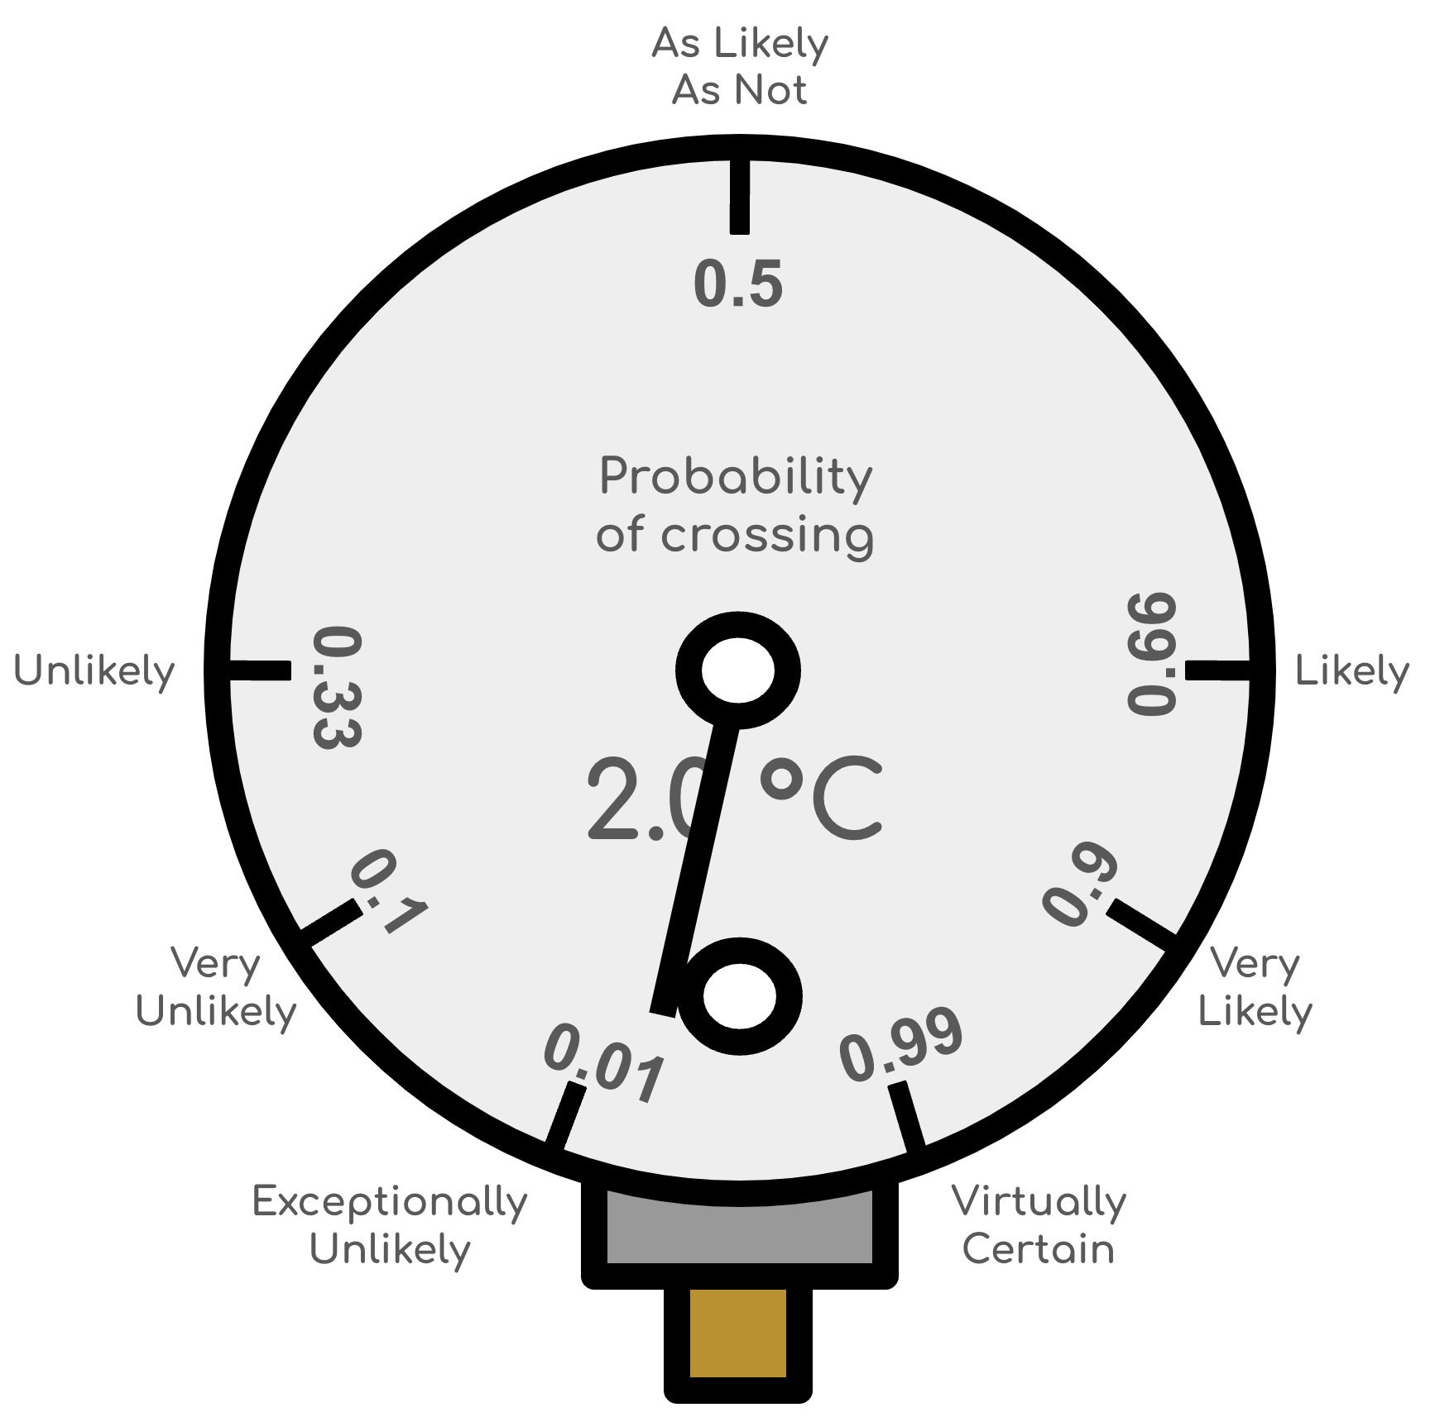
Observed Climate System Warming
Lines of Evidence:
Temperature Reconstructions
HadCRUT5, Kadow et al., Berkeley Earth, HadCRU_MLE, DCENT_MLE, NOAAGlobalTempv5.1, NOAAGlobalTempv6.0, China-MST2.0-Imax, and COBE-LSAT3
Climate Models
Emulators
CMIP5
CMIP6
EBM-KF
FAIR
Crossed: 1985
Crossed: 2011

Slide 8
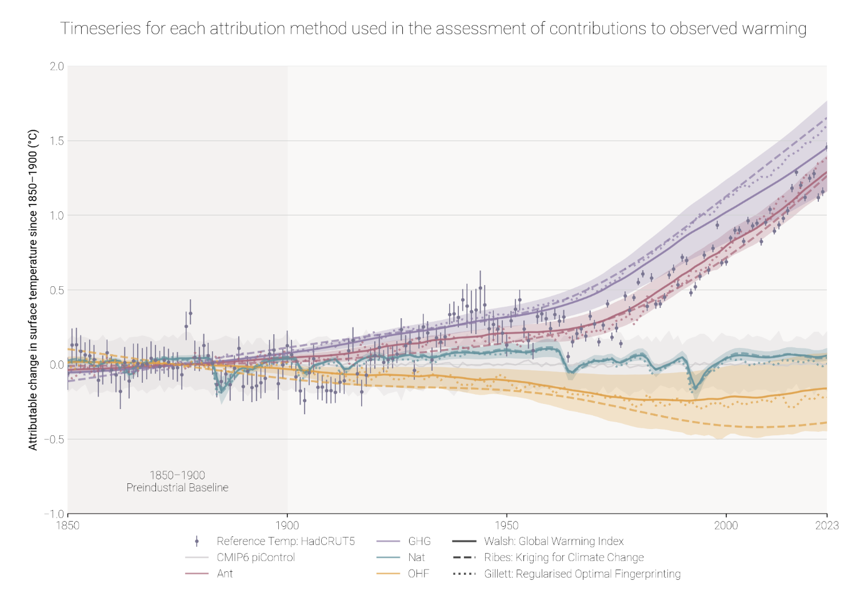
Attributed Climate System Warming
Lines of Evidence:
Emulators
Other Methods
Walsh–GWI
Ribes: Kriging
Gillett: ROF
EBM-KF
FAIR
Climate Models
CMIP5
CMIP6
Crossed: 1985
Crossed: 2011

Slide 9
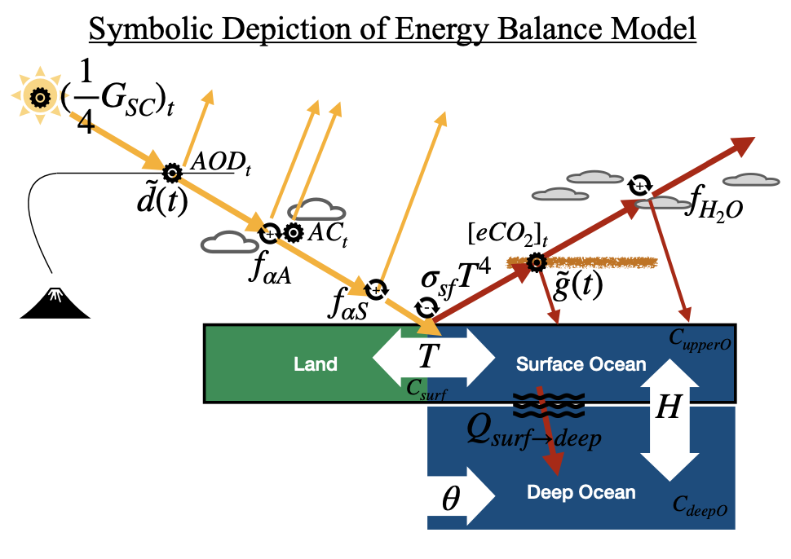
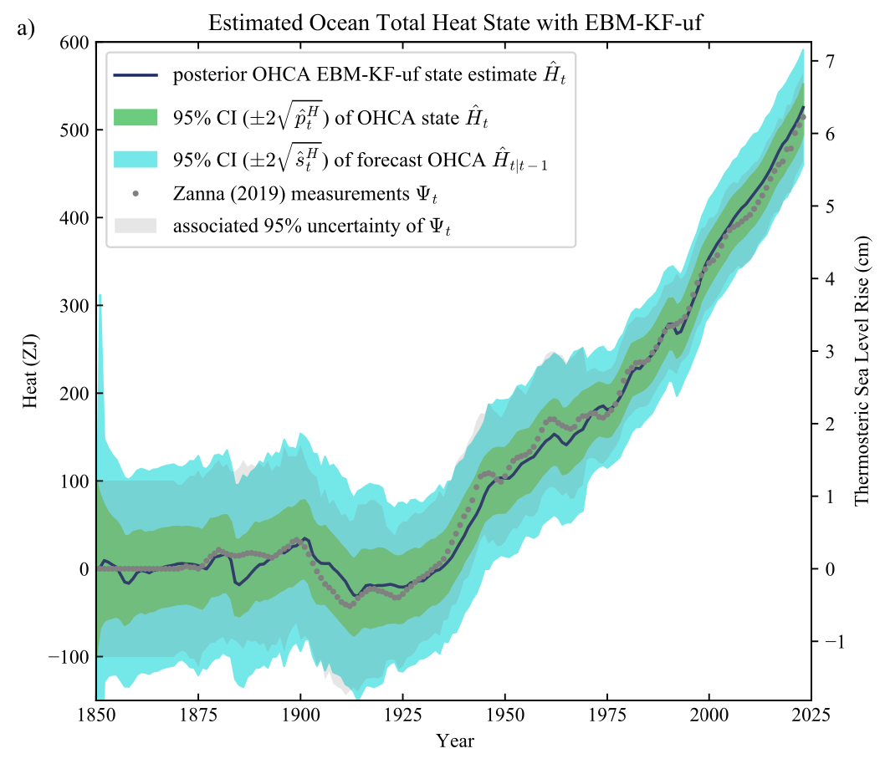
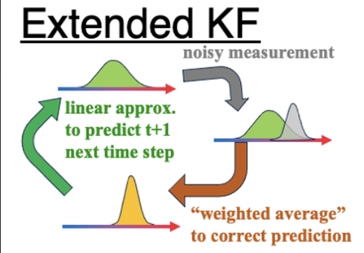
EBM-KF Climate System Warming
Key Reference:
Nicklas et al. 2024
http://dx.doi.org/10.1175/JCLI-D-23-0580.1
We present the Energy Balance Model – Kalman Filter (EBM-KF), a hybrid model projecting and assimilating the global mean surface temperature (GMST) and ocean heat content anomaly (OHCA). It combines an annual energy balance model (difference equations) with 17 parameters drawn from the literature and a statistical Extended Kalman Filter assimilating GMST and OHCA, either observed timeseries or simulated by earth system models.
Crossed: 1985
Crossed: 2011

Slide 11
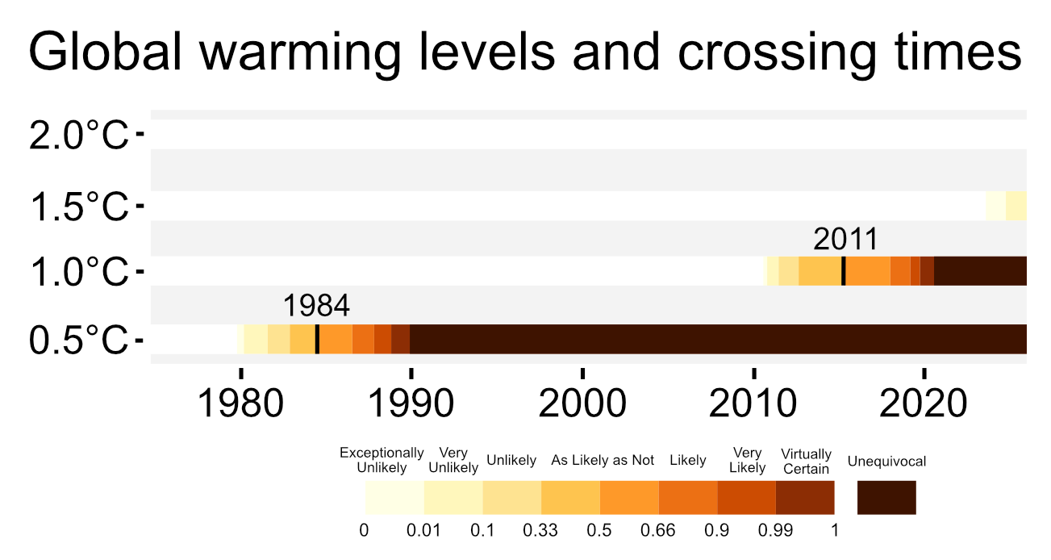
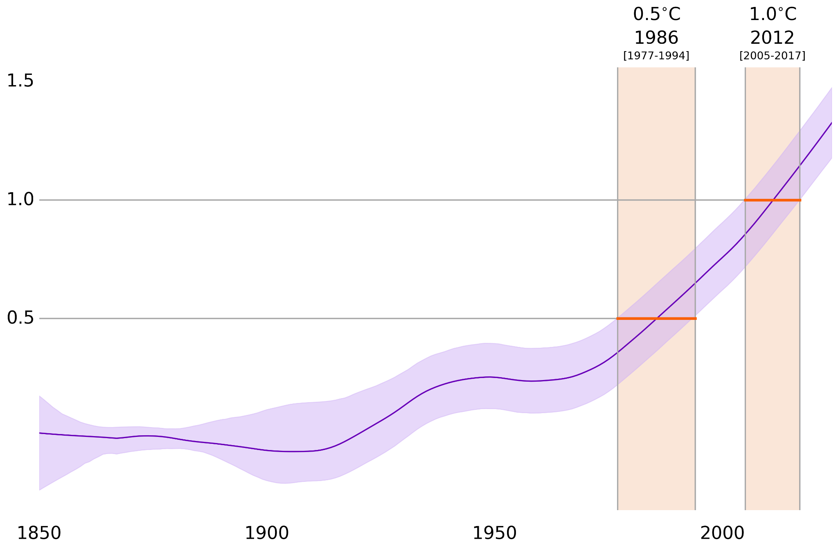
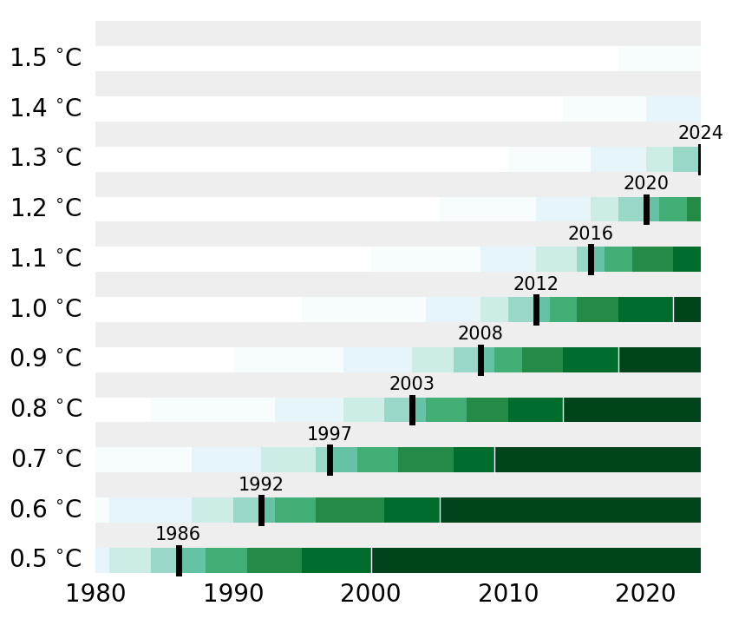

Slide 12
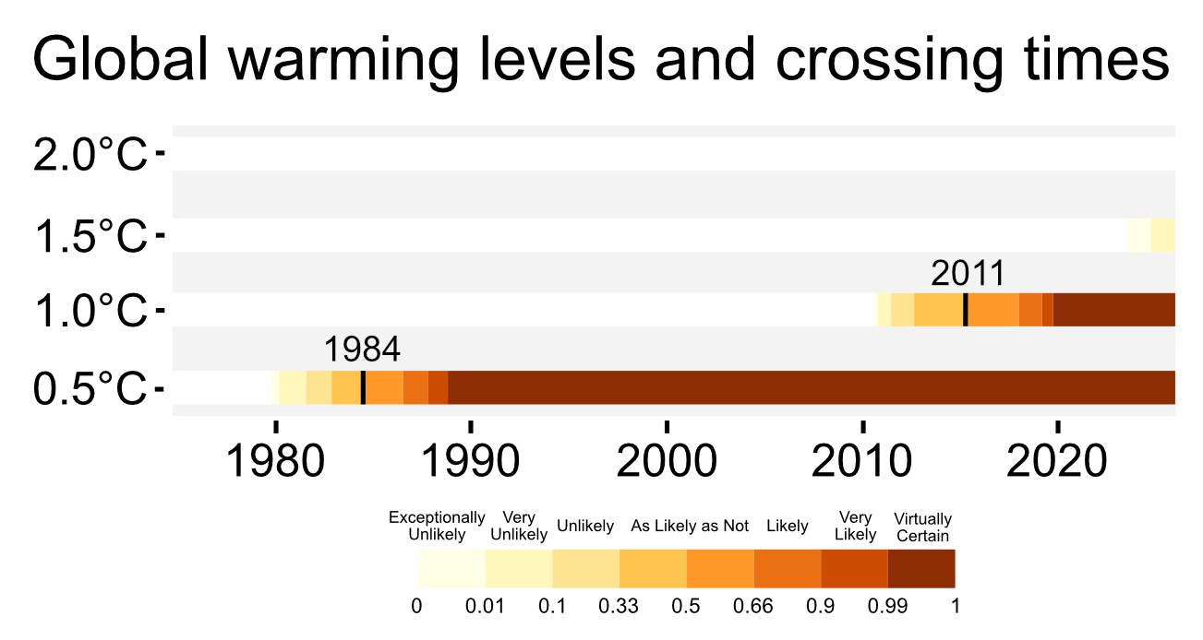
Climate system warming
Current global warming level 2023
1.3 °C [1.2 - 1.4, 95% uncertainty range]
It is exceptionally unlikely that global warming has exceeded 1.5°C
Download data - Explore lines of evidence

Slide 13
As Likely
As Not
0.5
Probability
of crossing
0.5 °C
Unlikely
0.33
0.66
Likely
0.1
0.9
Very
Unlikely
Very
Likely
0.01
0.99
Exceptionally
Unlikely
Virtually
Certain

Slide 14
As Likely
As Not
0.5
Probability
of crossing
1.0 °C
Unlikely
0.33
0.66
Likely
0.1
0.9
Very
Unlikely
Very
Likely
0.01
0.99
Exceptionally
Unlikely
Virtually
Certain

Slide 15
As Likely
As Not
0.5
Probability
of crossing
1.5 °C
Unlikely
0.33
0.66
Likely
0.1
0.9
Very
Unlikely
Very
Likely
0.01
0.99
Exceptionally
Unlikely
Virtually
Certain

Slide 16
As Likely
As Not
0.5
Probability
of crossing
2.0 °C
Unlikely
0.33
0.66
Likely
0.1
0.9
Very
Unlikely
Very
Likely
0.01
0.99
Exceptionally
Unlikely
Virtually
Certain

